Slide 1
File Handling in C++ using classes and STL
CSE-213
Object Oriented language

Slide 2
File handling is used to store data permanently in a computer. Using file handling we can store our data in secondary memory (Hard disk).
How to achieve the File Handling?
For achieving file handling we need to follow the following steps:-
STEP 1-Naming a file
STEP 2-Opening a file
STEP 3-Writing data into the file
STEP 4-Reading data from the file
STEP 5-Closing a file.

Slide 3
Streams in C++ :-
We give input to the executing program and the execution program gives back the output. The sequence of bytes given as input to the executing program and the sequence of bytes that comes as output from the executing program are called stream. In other words, streams are nothing but the flow of data in a sequence.
The input and output operation between the executing program and the devices like keyboard and monitor are known as “console I/O operation”. The input and output operation between the executing program and files are known as “disk I/O operation”.

Slide 4
Classes for File stream operations :-
The I/O system of C++ contains a set of classes which define the file handling methods. These include
ifstream,
ofstream and
fstream classes.
These classes are derived from
fstream and from the corresponding iostream class.

Slide 5
1. ios:-ios stands for input output stream.
2. istream:-istream stands for input stream.This class is derived from the class ‘ios’.
3. ostream:-ostream stands for output stream.This class is derived from the class ‘ios’.
4. streambuf:-This class contains a pointer which points to the buffer which is used to manage the input and output streams.
5. fstreambase:-This class provides operations common to the file streams. Serves as a base for fstream, ifstream and ofstream class.
6. ifstream:-This class provides input operations. Inherits the functions get(), getline(), read(), seekg() and tellg() functions from the istream.

Slide 6
7. ofstream:-This class provides output operations. Inherits the functions put(), write(), seekp() and tellp() functions from the ostream.
8. fstream:-This class provides support for simultaneous input and output operations.
9. filebuf:-Its purpose is to set the file buffers to read and write. We can also use file buffer member function to determine the length of the file.

Slide 7
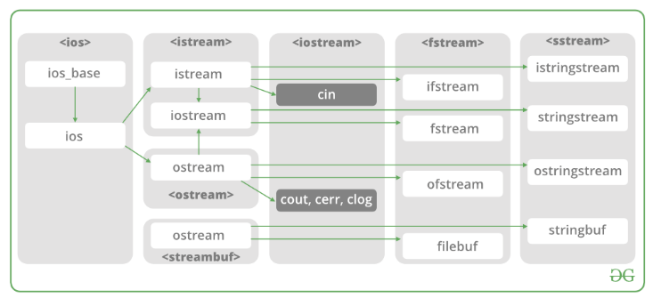
File Handling

Slide 8
Coding from lab

Slide 9
The C++ Standard Template Library (STL)
The Standard Template Library (STL) is a set of C++ template classes to provide common programming data structures and functions such as lists, stacks, arrays, etc. It is a library of container classes, algorithms, and iterators. It is a generalized library and so, its components are parameterized. Working knowledge of template classes is a prerequisite for working with STL.

Slide 10
Key components of the STL include:
Containers: The STL provides a range of containers, such as vector, list, map, set, and stack, which can be used to store and manipulate data.
Algorithms: The STL provides a range of algorithms, such as sort, find, and binary_search, which can be used to manipulate data stored in containers.
Iterators: Iterators are objects that provide a way to traverse the elements of a container. The STL provides a range of iterators, such as forward_iterator, bidirectional_iterator, and random_access_iterator, that can be used with different types of containers.

Slide 11
Function Objects: Function objects, also known as functors, are objects that can be used as function arguments to algorithms. They provide a way to pass a function to an algorithm, allowing you to customize its behavior.
Adapters: Adapters are components that modify the behavior of other components in the STL. For example, the reverse_iterator adapter can be used to reverse the order of elements in a container.

Slide 12
1. Algorithms
The header algorithm defines a collection of functions specially designed to be used on a range of elements. They act on containers and provide means for various operations for the contents of the containers.
Algorithm
Sorting
Searching
Important STL Algorithms
Useful Array algorithms
Partition Operations
Numeric
valarray class

Slide 13
2. Containers
Containers or container classes store objects and data. There are in total seven standards “first-class” container classes and three container adaptor classes and only seven header files that provide access to these containers or container adaptors.
Sequence Containers: implement data structures that can be accessed in a sequential manner.
vector
list
deque
arrays
forward_list( Introduced in C++11)
Container Adaptors: provide a different interface for sequential containers.
queue
priority_queue
stack

Slide 14
Associative Containers: implement sorted data structures that can be quickly searched (O(log n) complexity).
set
multiset
map
multimap
Unordered Associative Containers: implement unordered data structures that can be quickly searched

Slide 15
3.Functors
The STL includes classes that overload the function call operator. Instances of such classes are called function objects or functors. Functors allow the working of the associated function to be customized with the help of parameters to be passed.

Slide 16
4. Iterators
As the name suggests, iterators are used for working on a sequence of values. They are the major feature that allows generality in STL.

